Slide 1
UNIT I : Introduction to OOP
Comparison of procedural programming and Object-Oriented Programming
OOPs and its features
Data Types, Variables, static, constant, type conversions
Classes and objects
Inline functions, friend functions
Constructors and destructors
UML Diagrams- Introduction, Class diagram and its components
Class diagram relations and its multiplicity
UML use case diagram, use case , scenario
use case diagram objects and relations

Slide 2
Need of Object-Oriented Programming
Programming paradigm
Different approaches to build solutions to specific type of problems
One problem-solving technique:
Analyze the problem
Outline the problem requirements
Design steps (algorithm) to solve the problem
Algorithm:
Step-by-step problem-solving process
Solution achieved in finite amount of time

Slide 3
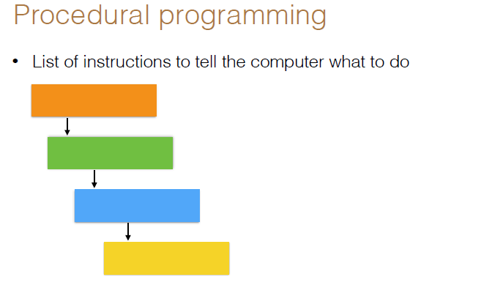
Need of Object-Oriented Programming

Slide 4
Structured programming
Structured programming (1960s)
Disciplined approach to writing programs
Clear, easy to test and debug, and easy to modify
Pascal
1971: Niklaus Wirth
Ada
1970s - early 1980s: US Department of Defense (DoD)
Multitasking
Programmer can specify many activities to run in parallel

Slide 5
The Key Software Trend: Object Technology
Objects
Reusable software components that model real world items
Meaningful software units
Date objects, time objects, paycheck objects, invoice objects, audio objects, video objects, file objects, record objects, etc.
Any noun can be represented as an object
More understandable, better organized and easier to maintain than procedural programming
Favor modularity
Software reuse
Libraries

Slide 6
Object oriented programming
Component of a program that knows how to perform certain actions and how to interact with other elements of the program
Features of OOP
Bottom–up approach in program design
Programs organised around objects, grouped in classes
Focus on data with methods to operate upon object’s data
Interaction between objects through functions
Reusability of design through creation of new classes by adding features to existing classes

Slide 7
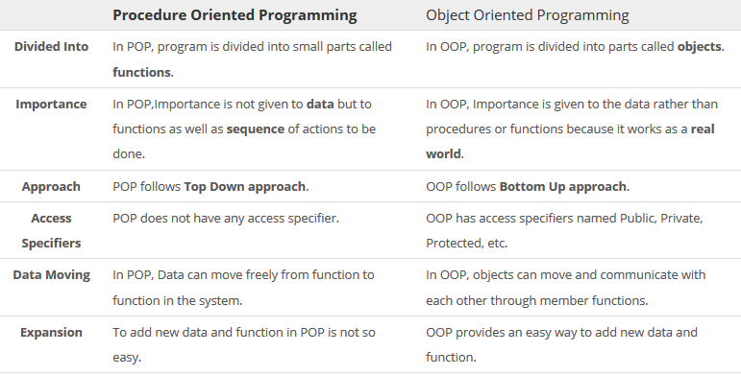
POP VS OOP

Slide 8

POP VS OOP

Slide 9
Procedural vs. Object-Oriented
Procedural application OO-application
DATA
Line of code
Line of code
Line of code
Data is stored
independent
of application
Each object is independent of
the others

Slide 10
Characteristics of Object-Oriented Languages
• Object
• Class
• Data Hiding and Encapsulation
• Dynamic Binding
• Message Passing
• Inheritance
• Polymorphism
Generic classes

Slide 11
Characteristics of OOP
Class– Basic building blocks OOP and a single entity which has data and operations on data together Objects – The instances of a class which are used in real functionality – its variables and operations Abstraction – Specifying what to do but not how to do ; a flexible feature for having a overall view of an object’s functionality. Encapsulation – Binding data and operations of data together in a single unit – A class adhere this feature Inheritance and class hierarchy – Reusability and extension of existing classes

Slide 12
Characteristics of OOP
Polymorphism – Multiple definitions for a single name - functions with same name with different functionality; saves time in investing many function names Operator and Function overloading Generic classes – Class definitions for unspecified data. They are known as container classes. They are flexible and reusable. Class libraries – Built-in language specific classes Message passing – Objects communicates through invoking methods and sending data to them. This feature of sending and receiving information among objects through function parameters is known as Message Passing.

Slide 13
Classes & Objects
Classes are templates that have methods and attribute names and type information, but no actual values!
Objects are generated by these classes and they actually contain values.
We design an application at the class level.
When the system is running objects are created by classes as they are needed to contain state information.
When objects are no longer needed by the application, they are eliminated.

Slide 14


Example of classes and objects

Slide 15


Example of classes and objects

Slide 16
Class & Objects
CLASS: Furniture
Name
methods: Example
ChangeNumber
Number
Objects:
Desk
ChairA
ChairB
123445
32143
45687

Slide 17
Inheritance
Use in the small, when a derived class "is-a" base class
enables code reuse
enables design reuse & polymorphic programming
Example:
a Student is-a Person
Person
Student
Employee
Undergraduate
Graduate
Staff
Faculty

Slide 18
Shape class hierarchy
Shape
TwoDimensionalShape
ThreeDimensionalShape
Circle
Square
Triangle
Sphere
Cube
Tetrahedron

Slide 19
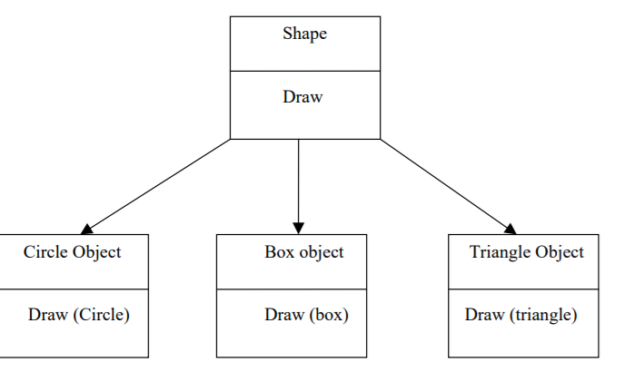
Polymorphism
Polymorphism is a property by which the same message can be sent to objects of several different classes and each object can respond in a different way depending on its class.

Slide 20
C++ Programming
History of C++
Extension of C
Early 1980s: Bjarne Stroustrup (Bell Laboratories)
Provides capabilities for object-oriented programming
Objects: reusable software components
Model items in real world
Object-oriented programs
Easy to understand, correct and modify
Hybrid language
C-like style
Object-oriented style
Both

Slide 21
Structure of C++ program
Declaration section includes different library functions and header files. All preprocessor directives are written in this section. Global declaration includes structure, class, variable. All global variables are declared here. Main() function is an entry point for all the function. Every C++ program starts with main() function.
In C++, the semicolon is a statement terminator.
C++ is a case-sensitive programming language. (Thus, Name and
name are two different identifiers in C++)

Slide 22
Structure of C++ program
Example : /* First C++ Program */
#include <iostream> using namespace std; int main() { cout<<"Welcome to SRM University"; return 0; }

Slide 23
A Simple Program: Printing a Line of Text
Before writing the programs
Comments
Document programs
Improve program readability
Ignored by compiler
Single-line comment
Use C’s comment /* .. */ OR Begin with // or
Preprocessor directives
Processed by preprocessor before compiling
Begin with #

Slide 24
Basics of a C++ Program
Common Input/output functions
cin
Standard input stream
Normally keyboard
cout
Standard output stream
Normally computer screen
cerr
Standard error stream
Display error messages

Slide 25
Basics of C++ program
/* First C++ Program */ 🡪/*...*/ comments are used for the documentation to understand the code to others. These comments are ignored by the compiler
#include<iostream> 🡪It is a preprocessor directive. It contains the contents of iostream header file in the program before compilation. This header file is required for input output statements.

Slide 26
Structure of C++ program
int/void -🡪Integer (int) returns a value. In the above program it returns value 0. Void does not return a value so there is no need to write return keyword.
main() 🡪It is an entry point of all the function where program execution begins.
Curly Braces {...}🡪It is used to group all statements together.
std::cout.🡪 It is requried when we use #include . Std::cout defines that we are using a name (cout) which belongs to namespace std.
Namespace is a new concept introduced by ANSI where C++ standard libraries are defined. If using namespace std is placed into the program then it does not required to write std:: throughout the code. Namespace std contains all the classes, objects and functions of the standard C++ library.

Slide 27
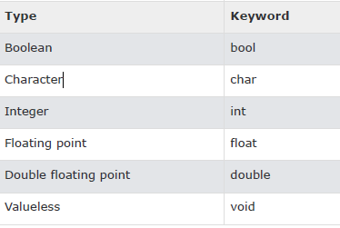
Data Types
A type defines a set of values and a set of operations that can be applied on those values. The set of values for each type is known as the domain for the type.
Data types in C++ is mainly divided into two types:
Primitive Data Types: These data types are built-in or predefined data types and can be used directly by the user to declare variables. Primitive data types includes:
Integer
Character
Boolean
Floating Point
Double Floating Point
Valueless or Void
Wide Character
Also : String
Abstract or user defined data type: These data types are defined by user itself. Like, defining a class in C++ or a structure.

Slide 28
Data Types
Integer: Keyword used for integer data types is int. Integers typically requires 4 bytes of memory space and ranges from -2147483648 to 2147483647.
Character: Character data type is used for storing characters. Keyword used for character data type is char. Characters typically requires 1 byte of memory
Boolean: Boolean data type is used for storing boolean or logical values. A boolean variable can store either true or false. Keyword used for boolean data type is bool.
Floating Point: Floating Point data type is used for storing single precision floating point values or decimal values. Keyword used for floating point data type is float. Float variables typically requires 4 byte of memory space.
Double Floating Point: Double Floating Point data type is used for storing double precision floating point values or decimal values. Keyword used for double floating point data type is double. Double variables typically requires 8 byte of memory space.
void: Void means without any value. void data type represents a valueless entity. Void data type is used for those function which does not returns a value.
Wide Character: Wide character data type is also a character data type but this data type has size greater than the normal 8-bit datatype. Represented by wchar_t. It is generally 2 or 4 bytes long.

Slide 29
Data Types
Datatype Modifiers: As the name implies, datatype modifiers are used with the built-in data types to modify the length of data that a particular data type can hold. Data type modifiers available in C++ are:
Signed
Unsigned
Short
Long

Slide 30
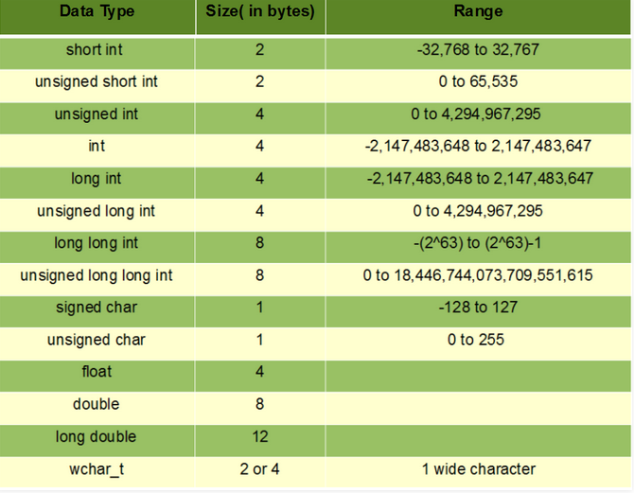

Slide 31
The string Type
a programmer-defined type
requires #include <string>
A string is a sequence of characters
"Hi Mom"
"We're Number 1!"
"75607"

Slide 32
C++ program using data types
// C++ program to sizes of data types
#include<iostream>
using namespace std;
int main()
{
cout << "Size of char : " << sizeof(char) << " byte" << endl;
cout << "Size of int : " << sizeof(int) << " bytes" << endl;
cout << "Size of short int : " << sizeof(short int) << " bytes" << endl;
cout << "Size of long int : " << sizeof(long int) << " bytes" << endl;
cout << "Size of signed long int : " << sizeof(signed long int) << " bytes" << endl;
cout << "Size of unsigned long int : " << sizeof(unsigned int) << " bytes" << endl;
cout << "Size of float : " << sizeof(float) << " bytes" <<endl;
cout << "Size of double : " << sizeof(double) << " bytes" << endl;
cout << "Size of wchar_t : " << sizeof(wchar_t) << " bytes" <<endl;
return 0;
}

Slide 33
Input
Storing data in the computer's memory requires two steps
Allocate the memory by declaring a variable
Have the program fetch a value from the input device and place it in the allocated memory location

Slide 34
Constants in c++
Integer data(decimal, octal, hexa)
Floating point
Character
String

Slide 35
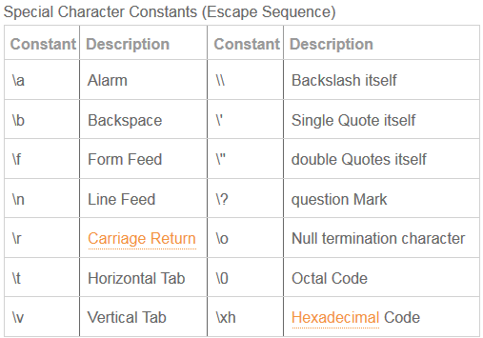
Special Character Constant

Slide 36
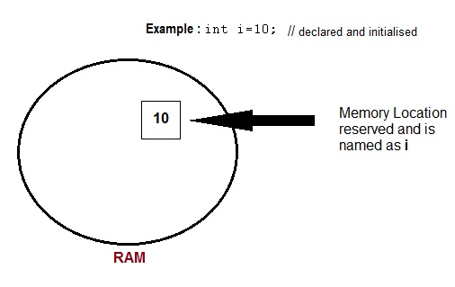
Variables
A variable definition means to tell the compiler where and how much to create the storage for the variable.

Slide 37
Variables
Rules for identifiers
must begin with letter or the underscore _
followed by any combination of numerals or letters
recommend meaningful identifiers

Slide 38
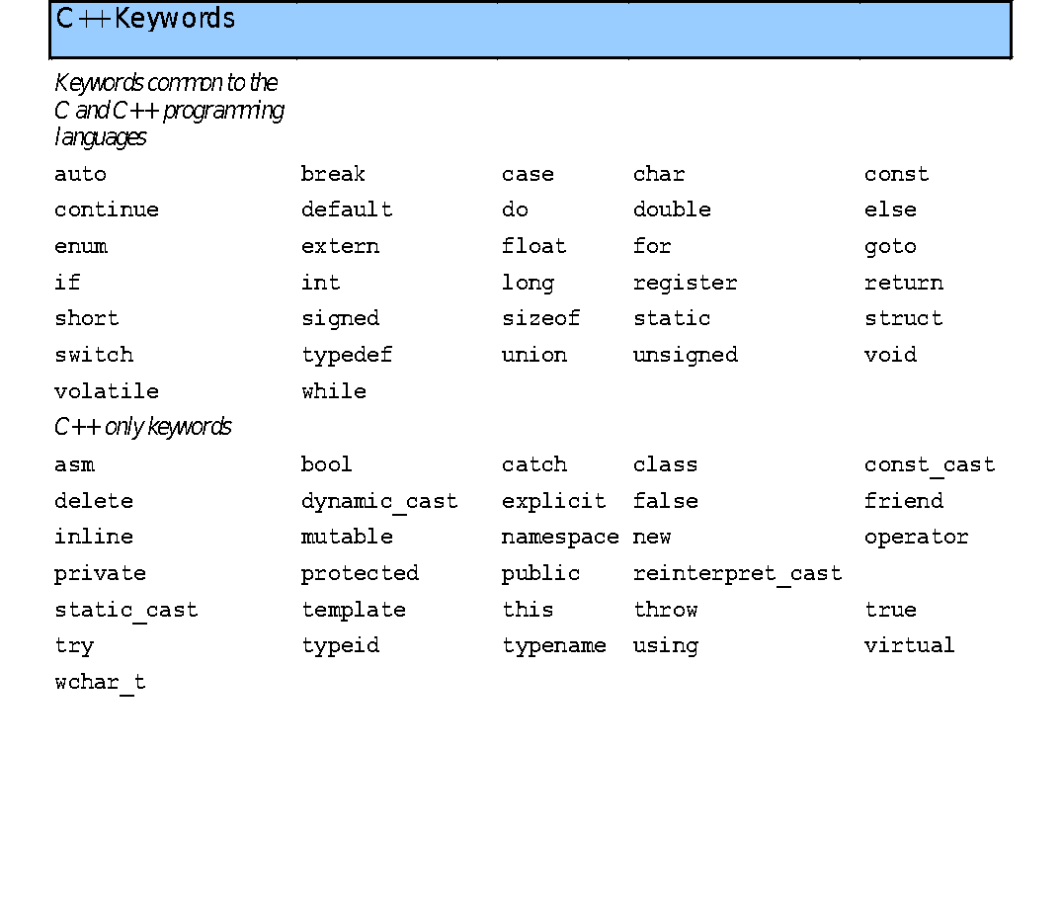
Keywords - Reserved words

Slide 39
Declarations
Constants and variables must be declared before they can be used.
A constant declaration specifies the type, the name and the value of the constant.
A variable declaration specifies the type, the name and possibly the initial value of the variable.
When you declare a constant or a variable, the compiler:
Reserves a memory location in which to store the value of the constant or variable.
Associates the name of the constant or variable with the memory location.

Slide 40
Variable declarations
Variables are used to store values that can be changed during the program execution.
A variable is best thought of as a container for a value.
Syntax:
< type > < identifier >;
< type > < identifier > = < expression>;
Examples:
int sum; //single declaration
float p,q,r; //multiple declaration
char answer = 'y';
double temperature = -3.14;

Slide 41
Variable declarations
A variable has a type and it can contain only values of that type. For example, a variable of the type int can only hold integer values.
Variables are not automatically initialized. For example, after declaration
int sum;
the value of the variable sum can be anything (garbage).
Thus, it is good practice to initialize variables when they are declared.
Once a value has been placed in a variable it stays there until the program deliberately alters it.

Slide 42
Variable declarations
int i; // declared but not initialised
char c;
int i, j, k; // Multiple declaration
int i; // declaration
i = 10; // initialization
int i=10; //initialization and declaration in same step
int i=10, j=11;

Slide 43
Variable Declartion
#include <iostream>
using namespace std;
int main ()
{
// Variable definition:
int a, b;
int c;
float f;
// actual initialization
a = 10;
b = 20;
c = a + b;
f = 70.0/3.0;
cout<<c<<endl<<f;
return 0;
}

Slide 44
Special types of variable
• Static - These variables holds their value between function calls.
#include <iostream.h>
using namespace std;
int main()
{
static int y=20;
}

Slide 45
Using the Static Storage Class Specifier
Using the static storage class specifier on a variable that normally would be automatic makes the variable static
Can use the static storage class specifier with variables declared inside functions
When the function is called the first time….
Variable is created and initialized to zero
Remains in existence for the remainder of the program
Scope of the variable remains unchanged
Can be used only in the block that declared it

Slide 46
Storage Classes, Scope and Linkage
Static Storage Class Specifier
void CountIt()
{
int count = 0; // auto variable created on each CountIt call
++count;
}
void CountIt()
{
static int count = 0; // variable created on first CountIt() call
++count;
}

Slide 47
Storage Classes
Static Storage Class Specifier
Static storage class specifier changes the linkage of static variables to internal linkage
Such change can only occur with variables declared outside functions
The scope of the variable remains unchanged
The variable can be used by any function in the implementation file

Slide 48
Constant declarations
Constants are used to store values that never change during the program execution.
Using constants makes programs more readable and maintainable.
Syntax:
const <type> <identifier> = <expression>;
Examples:
const double PI = 3.14159;
const double US2HK = 7.8;
//Exchange rate of US$ to HK$
const double HK2TW = 3.98;
//Exchange rate of HK$ to TW$
const double US2TW = US2HK * HK2TW;
//Exchange rate of US$ to TW$

Slide 49
Constant Variable
#include <iostream>
using namespace std;
int main()
{
const int LENGTH = 10;
const int WIDTH = 5;
const char NEWLINE = '\n';
int area;
area = LENGTH * WIDTH;
cout << area;
cout << NEWLINE;
return 0;
}

Slide 50
cin and the Extraction Operator >>
A binary operator
Takes two operands
Name of an input stream on the left
cin for standard input from keyboard
Variable on the right
Variables can be "cascaded" cin >> amount >> count >> direction;
Variables should generally be simple types

Slide 51
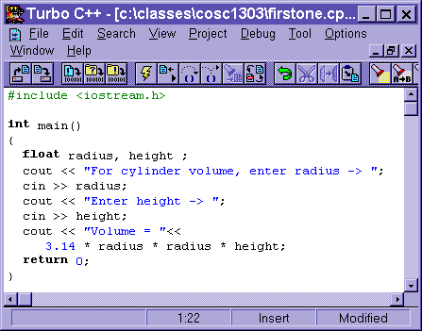
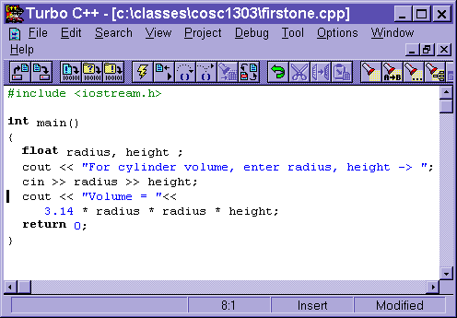
The Extraction Operator >>
Enables you to do input with the cin command
Think of the >> as pointing to where the data will end up
C++ able to handle different types of data and multiple inputs correctly

Slide 52
POINTERS
COMPUTER MEMORY
Each variable is assigned a memory slot (the size depends on the data type) and the variable’s data is stored there
Memory address:
1020
1024
1032
…
…
100
…
1024
…
a
Variable a’s value, i.e., 100, is
stored at memory location 1024
int a = 100;

Slide 53
Pointers
A pointer is a variable used to store the address of a memory cell.
We can use the pointer to reference this memory cell
Memory address:
1020
1024
1032
…
…
100
…
1024
…
integer
pointer

Slide 54
Pointer Types
Pointer
C++ has pointer types for each type of object
Pointers to int objects
Pointers to char objects
Pointers to user-defined objects
(e.g., Student, Complex,BookRationalNumber)
Even pointers to pointers
Pointers to pointers to int objects

Slide 55
Pointer Variable
Declaration of Pointer variables
type* pointer_name;
//or
type *pointer_name;
where type is the type of data pointed to (e.g. int, char, double)
Examples:
int *n;
RationalNumber *r;
int **p; // pointer to pointer

Slide 56
Address Operator &
The "address of " operator (&) gives the memory address of the variable
Usage: &variable_name
Memory address:
1020
1024
…
…
100
…
…
…
a
int a = 100;
//get the value,
cout << a; //prints 100
//get the memory address
cout << &a; //prints 1024

Slide 57
Address Operator &
Memory address:
1020
1024
1032
…
88
100
…
…
…
a
b
#include <iostream>
using namespace std;
void main(){
int a, b;
a = 88;
b = 100;
cout << "The address of a is: " << &a << endl;
cout << "The address of b is: " << &b << endl;
}
Result is:
The address of a is: 1020
The address of b is: 1024

Slide 58
Pointer Variables
The value of pointer p is the address of variable a
A pointer is also a variable, so it has its own memory address
Memory address:
1020
1024
1032
…
88
100
…
1024
…
a
p
int a = 100;
int *p = &a;
cout << a << " " << &a <<endl;
cout << p << " " << &p <<endl;
Result is:
100 1024
1024 1032

Slide 59
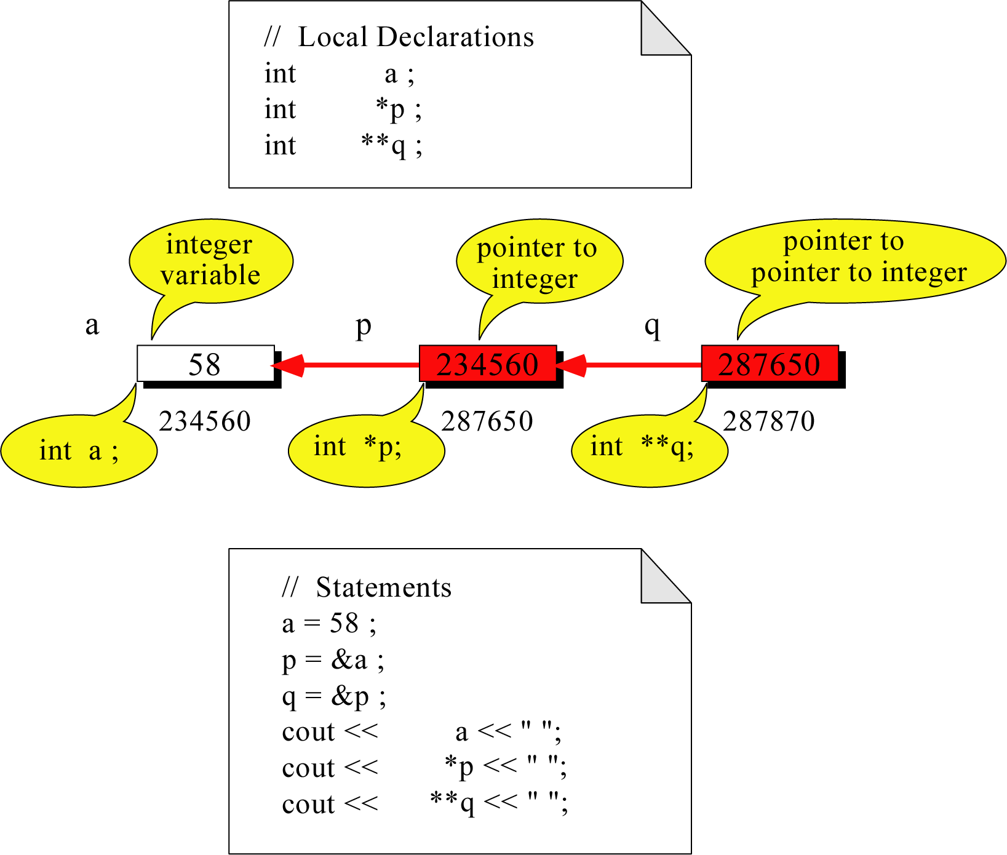
Pointer to Pointer
What is the output?
58 58 58

Slide 60
Dereferencing Operator *
We can access to the value stored in the variable pointed to by using the dereferencing operator (*),
Memory address:
1020
1024
1032
…
88
100
…
1024
…
a
p
int a = 100;
int *p = &a;
cout << a << endl;
cout << &a << endl;
cout << p << " " << *p << endl;
cout << &p << endl;
Result is:
100
1024
1024 100
1032

Slide 61
Don’t get confused
Declaring a pointer means only that it is a pointer: int *p;
Don’t be confused with the dereferencing operator, which is also written with an asterisk (*). They are simply two different tasks represented with the same sign
int a = 100, b = 88, c = 8;
int *p1 = &a, *p2, *p3 = &c;
p2 = &b; // p2 points to b
p2 = p1; // p2 points to a
b = *p3; //assign c to b
*p2 = *p3; //assign c to a
cout << a << b << c;
Result is:
888

Slide 62
A Pointer Example
Memory Layout
The code
void doubleIt(int x, int * p)
{
*p = 2 * x;
}
int main(int argc, const char * argv[])
{
int a = 16;
doubleIt(9, &a);
return 0;
}
Box diagram
main
16
p (8200)
8192
a
doubleIt
x (8196)
9
a (8192)
16
main
doubleIt
x
9
a gets 18
p
Notes:
Note the signature of main() – it’s an array parameter. And, like other examples we’ve given, it takes the number of elements as a parameter. Why?

Slide 63
Another Pointer Example
Let’s figure out:
value1==? / value2==?
Also, p1=? p2=?
#include <iostream>
using namespace std;
int main (){
int value1 = 5, value2 = 15;
int *p1, *p2;
p1 = &value1; // p1 = address of value1
p2 = &value2; // p2 = address of value2
*p1 = 10; // value pointed to by p1=10
*p2 = *p1; // value pointed to by p2= value // pointed to by p1
p1 = p2; // p1 = p2 (pointer value copied)
*p1 = 20; // value pointed to by p1 = 20
cout << "value1==" << value1 << "/ value2==" << value2;
return 0;
}

Slide 64
Reference Variables
A reference is an additional name to
an existing memory location
Pointer:
Reference:
x
9
x
ref
9
ref
int x = 9;
int &ref = x;
int x=9;
int *ref;
ref = &x;
Notes:
References fix some of those pointer problems.
If we wanted something called “ref” to point to a variable x, we’d declare a pointer variable and assign the address of x into it. With references, we’d attach an additional name – ref – to the same memory location as x.
Note how the pointer necessitates an extra variable, whereas the reference didn’t

Slide 65
Reference Variables
A reference variable serves as an alternative name for an object
int m = 10;
int &j = m; // j is a reference variable
cout << “value of m = “ << m << endl;
//print 10
j = 18;
cout << “value of m = “ << m << endl;
// print 18

Slide 66
Reference Variables
A reference variable always refers to the same object. Assigning a reference variable with a new value actually changes the value of the referred object.
Reference variables are commonly used for parameter passing to a function

Slide 67
Traditional Pointer Usage
void IndirectSwap(char *Ptr1, char *Ptr2){
char temp = *Ptr1;
*Ptr1 = *Ptr2;
*Ptr2 = temp;
}
int main() {
char a = 'y';
char b = 'n';
IndirectSwap(&a, &b);
cout << a << b << endl;
return 0;
}

Slide 68
Pass by Reference
void IndirectSwap(char& y, char& z) {
char temp = y;
y = z;
z = temp;
}
int main() {
char a = 'y';
char b = 'n';
IndirectSwap(a, b);
cout << a << b << endl;
return 0;
}

Slide 69
Type Conversions
C++ facilitates type conversion into 2 forms :
Implicit Type Conversion - performed by the compiler without programmer’s intervention.
--The C++ compiler converts all operands upto the type of the largest operand, which is called type promotion.
Explicit Type Conversion
Explicit conversion can be done using type cast operator and the general syntax for doing this is :
datatype (expression);

Slide 70
Type Conversions
#include <iostream>
using namespace std;
void main(){
int a;float b,c;
cout << "Enter the value of a:";
cin >> a;
cout << "Enter the value of b:";
cin >> b;
c = float(a)+b;
cout << "The value of c is:" << c;

Slide 71
Type Cast Operator
C++ permit explicit type conversion of variables or expressions using the type cast operator.
(type-name) expression // C notation
type-name ( expression ) // C++ notation
// like a function call
// notation
eg:- average = sum /(float) i; // C notation
average = sum / float(i); // C++ notation

Slide 72
Type Cast Operator
continue…
p = int * ( q ); // is illegal
p = ( int * ) q; // is legal
Alternatively, we can use typedef to create an identifier of the required type.
typedef int * int_pt;
p = int_pt ( q );
The type name should be an identifier

Slide 73
Type Conversions
we have four specific casting operators:
static_cast <new_type> (expression) const_cast <new_type> (expression) dynamic_cast <new_type> (expression) reinterpret_cast <new_type> (expression)

Slide 74
Scope of variables
• Global Variables
• Local variables
include <iostream>
using namespace std;
int x; // Global variable declared
int main()
{
int a; // Local variable declared
x=10; // Initialized once
cout <<"first value of x = "<< x;
x=20; // Initialized again
a=10; // Initialized once
cout <<"Initialized again with value = "<< x;
}

Slide 75
Scope Resolution Operator
C++ is a block structured language. The scope of a variable extends from the point of its declaration till the end of the block containing the declaration. A variable declared inside a block is said to be local to that block.
………
………
{
int x = 10;
………
………
}
………
………
{
int x = 1;
………
………
}

Slide 76
Scope Resolution Operator
continue…
Blocks in C++ are often nested.
In C, the global version of a variable can not be accessed from within the inner block.
C++ resolved this problem with the use of the scope resolution operator ( :: ).
………
………
{
int x = 10;
……… Block1
………
{
int x = 1;
……… Block 2
………
}
………
………
}

Slide 77
Scope Resolution Operator
continue…
The scope resolution operator ( :: ) can be used to uncover a hidden variable.
: : variable-name
This operator allows access to the global version of a variable.

Slide 78
Scope Resolution Operator
continue…
#include<iostream.h>
#include<conio.h>
int m = 10;
void main( )
{
int m = 20;
clrscr( );
cout << "m_local = " << m << "\n";
cout << "m_global = " <<::m << "\n";
getch( );
}
m_local = 20
m_global = 10

Slide 79
Memory Management Operators
malloc( ) and calloc( ) functions are used to allocate memory dynamically at run time.
The function free( ) to free dynamically the allocated memory.
The unary operators new and delete perform
the task of allocating and freeing the memory.
C
&
C++
C++

Slide 80
Memory Management Operators
continue…
new to create an object
delete to destroy an object
A data object created inside a block with new, will remain in existence until it is explicitly destroyed by using delete.
Thus the life time of an object is directly under our control and is unrelated to the block structure of the program.

Slide 81
Memory Management Operators
continue…
new to create an object
The data-type may be any valid data type
pointer-variable = new data-type;
pointer-variable is a pointer of type data-type
The new operator allocates sufficient memory to hold a data object of type data-type and returns the address of the object
The pointer-variable holds the address of the memory space allocated

Slide 82
Memory Management Operators
continue…
pointer-variable = new data-type;
p = new int; // p is a pointer of type int
q = new float; // q is a pointer of type float
Here p and q must have already been declared as pointers of appropriate types.
Alternatively, we can combine the declaration of pointers and their assignments as:
int *p = new int;
float *q = new float;

Slide 83
Memory Management Operators
continue…
int *p = new int;
float *q = new float;
*p = 25; // assign 25 to the newly created int object
*q = 7.5; // assign 7.5 to the newly created float object
pointer-variable = new data-type (value);
int *p = new int ( 25 );
float *q = new float ( 7.5 );

Slide 84
Memory Management Operators
continue…
delete to destroy an object
delete pointer-variable;
When a data object is no longer needed, it is destroyed to release the memory space for reuse.
delete p;
delete q;
delete [ size ] pointer-variable;
The size specifies the number of elements in the array to be freed.
delete [ ]p; // delete the entire array pointed to by p

Slide 85
Manipulators
Manipulators are operators that are used to format the data display.
Commonly used manipulators are:
endl // causes a line feed when used in an
// output statement
setw // to specify field width and force the
// data to be printed right-justified

Slide 86
Manipulators
continue…
#include<iostream>
#includeiomanip>
using namespace std;
void main( )
{
int m, n, p;
m = 2597;
n = 14;
p = 175;
cout <<setw(10) << "First = " <<setw(10) << m << endl
<<setw(10) << "Second = " << setw(10) << n << endl
<<setw(10) << "Third = " << setw(10) << p << endl;
}
First = 2597
Second = 14
Third = 175

Slide 87
An Introduction to classes
Typically
Programs will consist of
Function main and
One or more classes
Each containing data members and member functions
A class is a building block of OOP. It is the way to bind the data and its logically related functions together.
An abstract data type/plan/blueprint that can be treated like any other built in data type.

Slide 88
Class definition
Class head
Class body
class name_of_class
{ private:
data member( s);
member function(s);
public:
data member( s);
member function(s);
};

Slide 89
Example
int big()
{
if (a > b)
return a;
else
return b;
}
};
class test
{
private :
int a;
int b;
public:
void set_data(int x, int y)
{
a=x;
b=y;
}
Class declaration and definition :
Does not allocate memory

Slide 90
Characteristics of access specifiers (private,public and protected)
Private section of a class can have both data members and member functions, usually data members are made private for data security.
It is not mandatory that private section has to declared first in the class and then the public section.
If no member access specifier is specified then by default the members are private for the class.
There may be any number of private, public or protected section in a class declaration.
Protected specifier is used for declaring the class members which can be accessed by its own class and its derived class.

Slide 91
Member Function
Member function’s name is visible outside the class.
It can be defined inside or outside the class.
It can have access to private, public and protected data members of its class, but cannot access private data members of another class.
When defining a member function:
Put prototype in class declaration
Define function using class name and scope resolution operator (::)
return-type ClassName::functionName parameters)
{
function-body;
}

Slide 92
Introduction to objects
Object is an abstraction of real wold entity.
Objects are the variables/instances of classes.
Syntax for declaring objects is as follows :
<class name> <obj_name1>,<obj_name2>, …, <obj_name1>;
Example: for class test the objects can be created as follows:
test t1,t2,…tn;

Slide 93
Characteristics of objects:
It can have its own copy of data members.
The scope of an object is determined by the place in which the object is defined.
It can be passed to a function like normal variables.
The members of the class can accessed by the object using the object to member access operator or dot operator(.).

Slide 94
Example
class test
{ private :
int a;
int b;
public:
void set_data(int x, int y)
{
a=x;
b=y;
}
int big() {
if (a > b) return a;
else return b;
}
};
void main()
{
test t;
int a,b;
cout<<“enter the two numbers” << endl;
cin>> a >> b;
t.set_data(a,b);
cout<<“the largest number is ” << t.big();
}

Slide 95
More about classes
Its recommended to start the class name with an uppercase letter.
If class name is made of more than one word, then first letter of each word must be in uppercase.
Example class Study
Class in C++ are similar to structures in C, the only difference being, class defaults to private access control, where as structure defaults to public.
All the features of OOPS, revolve around classes in C++. Inheritance, Encapsulation, Abstraction etc.
Objects of class holds separate copies of data members. We can create as many objects of a class as we need

Slide 96
Access control in classes
public
private
protected
These access specifiers are used to set boundaries for availability of members of class be it data members or member function
Public : A public member is accessible from anywhere outside the class but within a program.
private : A private member variable or function cannot be accessed, or even viewed from outside the class. Only the class and friend functions can access private members.
protected : A protected member variable or function is very similar to a private member but it provided one additional benefit that they can be accessed in child classes which are called derived classes

Slide 97
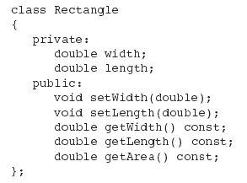
Access Specifiers
Private Members
Public Members

Slide 98
Private Members
Making data members private provides data protection
Data can be accessed only through public functions
Public functions define the class’s public interface

Slide 99
Example for int, float in class
#include <iostream>
using namespace std;
class temp
{
private:
int data1;
float data2;
public:
void int_data(int d){
data1=d;
cout<<"Number: "<<data1;
}
float float_data(){
cout<<"\nEnter data: ";
cin>>data2;
return data2;
}
};
int main(){
temp obj1, obj2;
obj1.int_data(12);
cout<<"You entered "<<obj2.float_data();
return 0;
}

Slide 100
Definition of function outside a class.
The syntax for defining function outside a class is as follows:
<data type> <class name> :: <function name> ()
{
// member function definition
}
Data type 🡪 return type
Class name 🡪 the class to which the member function belongs.
Function name 🡪 name of member function.

Slide 101
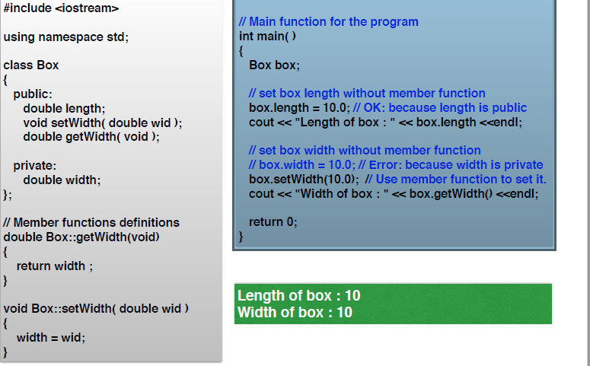
Access Specifier - accessing private data outside class

Slide 102
Example:Member outside the class
void test :: set_data(int x, int y)
{
a=x;
b=y;
}
int test :: big()
{
if (a > b)
return a;
Else
return b;
}
Class test
{
private :
int a;
int b;
public:
void set_data(int,int );
int big();
};
Main() as given in the previous program

Slide 103
int main()
{
Student st[5];
for( int i=0; i<5; i++ )
{
cout << "Student " << i + 1 << endl;
cout << "Enter name" << endl;
st[i].getName();
cout << "Enter marks" << endl;
st[i].getMarks();
}
for( int i=0; i<5; i++ )
{
cout << "Student " << i + 1 << endl;
st[i].displayInfo();
}
return 0;
}
#include <iostream>
#include <string>
using namespace std;
class Student
{
string name;
int marks;
public:
void getName()
{
getline( cin, name );
}
void getMarks()
{
cin >> marks;
}
void displayInfo()
{
cout << "Name : " << name << endl;
cout << "Marks : " << marks << endl;
}
};

Slide 104
The Arrow operator(pointer to member)
It is also called as pointer to member access operator.
It is used when member functions or member data has to access through a pointer which is pointing to an object of a class.
Syntax for using arrow operator is :
Pointer_to_object -> class_member;

Slide 105
Example of arrow operator
Class test1
{
private :
int a;
int b;
public:
void add(int , int );
};
void test1 :: add(int x, int y)
{
a=x;
b=y;
return (a+b);
}
void main()
{
int sum;
test1 t;
sum = t.add(4,9)
cout<< sum << endl;
test1 *t1 = &t;
sum = t1 -> add(2,7);
cout<< sum<<endl;
}
Output:
13
9 // add called by pointer to member

Slide 106
This operator
It is a keyword used to store the address of the object that invokes a member function.
When each member function is invoked this pointer implicitly holds the address of the object itself.
It is defined internally.
When an object is used to invoked a class member function then the address of that object is automatically assigned to the this pointer.

Slide 107
Example showing the explicit use of this pointer :
#include<iostream>
class simple
{
int a;
public:
void set_data( int x)
{
this -> a = x;
}
void display()
{
cout<<this -> a<<endl;
cout<<“address of the object is =”<< this<<endl;
}
};
void main()
{
simple s;
s.set_data(7);
s.display();
}
Output:
7
address of the object is = 0X8feeff4

Slide 108
Passing Objects as Arguments
Objects are passed to functions through the use of the standard call-by-value mechanism.
Means that a copy of an object is made when it is passed to a function.

Slide 109
Object Assignment
20, Shilpa
Only
If Instances of same
Class!!
20, Shilpa
=
void read_data( )
void read_data( )
void print_data( )
void print_data( )
emp1
emp2

Slide 110
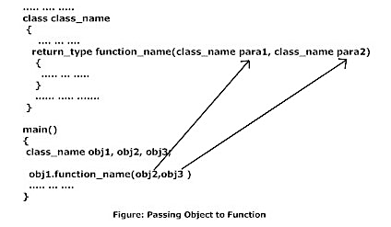
Passing Objects as arguments

Slide 111
Passing Objects as Arguments
class complex
{
……
.…..
void Add(int x, complex c);
……
……
};
void main()
{
complex obj, s1;
……
……
……
obj.Add(6, s1) ;
……
……
}

Slide 112
Example
class Complex
{
private:
int real;
int imag;
public:
void Read()
{ cout<<"Enter real and imaginary number”;
cin>>real>>imag; }
void Add(Complex comp1,Complex comp2)
{ real=comp1.real+comp2.real;
imag=comp1.imag+comp2.imag;
}
void Display()
{ cout<<"Sum="<<real<<"+"<<imag<<"i“; }
};
int main()
{
Complex c1,c2,c3;
c1.Read();
c2.Read();
c3.Add(c1,c2);
c3.Display();
return 0;
}
Enter real and imaginary
Number :
12
3
Enter real and imaginary
Number :
2
6
Sum=14+9i

Slide 113
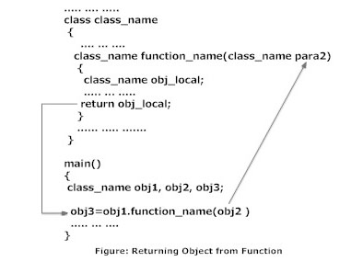
Returning Objects from functions

Slide 114
Example
#include <iostream>
using namespace std;
class Complex
{ private:
int real; int imag;
public:
void Read()
{ cin>>real>>imag; }
Complex Add(Complex comp2)
{ Complex temp;
temp.real=real+comp2.real;
temp.imag=imag+comp2.imag;
return temp; }
void Display()
{
cout<<"Sum="<<real<<"+"<<imag<<"i";
}
};
int main()
{
Complex c1,c2,c3;
c1.Read();
c2.Read();
c3=c1.Add(c2);
c3.Display();
return 0;
}

Slide 115
Inline functions
When a Function is called:
Objective of using functions:
To save memory space, when a function is likely to be called many times.
Jumping to a function
Saving the registers
Pushing arguments in to the stack
Returning to the calling function
When a function is small enough (only one line of code) these things would be a wastage of time and resources.

Slide 116
Inline Functions
If a function is inline than:
Compiler puts its code at the place where it is called at compile time
To define a function as inline function
use the keyword “inline” just before the return type.
The compiler ignore the inline qualifier in case defined function is more than a line.
inline return_type function_name(args)
{
//one line code
}

Slide 117
Workings of Inline
The inline function is just a code replacement instead of the function call.
There is a need of stack storage and other special mechanism for function call and return.
The stack storage is used to store the return value and return address for function call and return process.
And while passing the parameter the stack storage needed to store the parameter values, and from the stack area the values moved to data area.

Slide 118
Workings of Inline
While using the inline function, there is no need of these operations, because of code replacement.
The compiler can do inline on either a high-level intermediate representation or a low-level intermediate representation.
In either case, the compiler simply computes the arguments, stores them in variables corresponding to the function's arguments, and then inserts the body of the function at the call site.

Slide 119
Inline Function (example)
#include <iostream>
using namespace std;
inline int Max(int x, int y)
{
return (x > y)? x : y;
}
// Main function for the program
int main( )
{
cout << "Max (20,10): " << Max(20,10) << endl;
cout << "Max (0,200): " << Max(0,200) << endl;
cout << "Max (100,1010): " << Max(100,1010) << endl;
return 0;
}
Output:
Max (20,10): 20
Max (0,200): 200
Max (100,1010): 1010

Slide 120
Inline Functions Restrictions….
The inline function must be simple and small.
If the code size is too large, some compiler will not treat that as inline function.
The inline expansion can not be recognized by the programmer. If the function is not treated as inline, then it will take care of compiler as normal function.

Slide 121
When inline may not work
In the following situation inline expansion may not work:
1.For function returning values, if a loop, a switch or goto exists.
2.For function not returning values, if a return statement exists.
3.If function contains static variables.
4.If inline function are recursive.

Slide 122
Inline function and classes:
It is also possible to define the inline function inside the class. In fact, all the functions defined inside the class are implicitly inline. Thus, all the restrictions of inline functions are also applied here. If you need to explicitly declare inline function in the class then just declare the function inside the class and define it outside the class using inline keyword.

Slide 123
Inline function and classes:
class S
{
public:
inline int square(int s)
{
// this function is automatically inline
// function body
}
};
class S
{
public:
int square(int s);
// declare the function
};
inline int S::square(int s)
// use inline prefix
{
}

Slide 124
friend functions and friend classes
By default : functions and data of a class are private to that class
Only the public members are accessible outside the class
Protected members can be inherited along with public members
No such condition where private members can be accessed from outside the class
So Friend Functions and Friend Classes may be used where our application requires the access all the members of a class

Slide 125
#include <iostream>
class A {
private:
int a;
public:
A() { a = 0; }
friend class B; // Friend Class
};
class B {
private:
int b;
public:
void showA(A& x)
{
// Since B is friend of A, it can access
// private members of A
std::cout << "A::a=" << x.a;
}
};
int main()
{
A a;
B b;
b.showA(a);
return 0;
}

Slide 126
Features of Friend functions:
Not a member of the class
Invoked like normal function without any object
Full access to private and protected members
Of the class
But can use the members for one or more specific objects
Called without the use dot operator(does not need to be qualified with object’s name)

Slide 127
How to declare?
Include its prototype in the class , preceding it with keyword friend
Syntax:
friend ret_type func_name(arguments);
Can be declared anywhere (in public, protected or private section) in the class
May have no arguments
Objects of the class or their pointers can be passed as arguments to the friend function

Slide 128
Example:
Class myclass
{ int a,b;
Public:
myclass(int x,int y)
{ a=x; b=y; }
friend int sum(myclass m); // declaration
}
int sum(myclass m)
{ return m.a+ m.b; }
void main()
{ myclass my(10,20);
cout<<sum(my); //calling the friend function
}

Slide 129
Usage of friend classes:
As a function can be friend of more than one class, it can be used for message passing between the classes.
As it is not a member of the class ,it does not have a this pointer. So can be used for Operator overloading. The operands are passed explicitly to the overloaded friend operator function.
Make I/O functions easier

Slide 130
Example: Function As Friend Of More Than One Class
class A; // forward declaration
class B
{
int b;
friend int sum(A a1, B b1);
};
class A
{
int a;
friend int sum(A a1, B b1);
};
int sum (A a1,B b1)
{
return a1.a + b1.b;
}

Slide 131
Static data members and functions
static data member a data member for which one copy is shared by all objects of a class
Some common uses:
• instance counters
• class-wide attribute settings
• class-wide assocations
A static member is simply declared with the reserved word static.
static function member a member function that can be called independently of the existence of any class object
Static member functions are only allowed to access data members that are static. Why?

Slide 132
Static data members
Declaration :
static data_type member_name;
Defining the static data member It should be defined outside of the class following this syntax:
data_type class_name :: member_name =value;
Accessing
class_name :: static_data_member;

Slide 133
Static data members -public
class Demo {
public:
static int ABC;
};
//defining
int Demo :: ABC =10;
int main()
{ cout<<"\nValue of ABC: "<<Demo::ABC;
//accessing static data member
return 0; }

Slide 134
Static data member - private
class Demo {
private:
static int X;
public:
static void fun()
{
cout <<" X: " << X << endl;
}
};
//defining
int Demo :: X =10;
//public or private has to be defined
int main() {
Demo X;
X.fun();
return 0;
}

Slide 135
Static member functions
A static member function is a special member function, which is used to access only static data members,
To access :
class_name:: function_name(parameter);

Slide 136
Static member functions
class stat {
int code;
static int count;
public:
void stat()
{ code = ++count; }
void showcode() {
cout << “Obj num:" << code;
}
static void showcount() {
cout << “Count Objects :" << count;
} };
int stat::count;
main() {
stat obj1, obj2; obj1.showcount(); obj1.showcode(); obj2.showcount(); obj2.showcode();
}
Count Objects: 2
Obj Num: 1
Count Objects: 2
Obj Num is: 2

Slide 137
Static member functions
class IDGenerator
{ static int s_nextID
public:
static int getNextID() {
return s_nextID++;
} };
int IDGenerator::s_nextID = 1;
int main()
{ for (int count=0; count < 5; ++count)
cout << "The next ID is: “”;
cout<<IDGenerator::getNextID() << endl;
}
Output :
The next ID is: 1
The next ID is: 2
The next ID is: 3
The next ID is: 4
The next ID is: 5

Slide 138
Constructors
A constructor is a special member function whose task is to initialize the objects of its class.
It is special because its name is same as the class name.
The constructor is invoked whenever an object of its associated class is created.
It is called constructor because it constructs the values of data members of the class.

Slide 139
Constructor - example
class add
{
int m, n ;
public :
add (void) ;
------
};
add :: add (void)
{
m = 0; n = 0;
}
When a class contains a constructor, it is guaranteed that an object created by the class will be initialized automatically.
add a ;
Not only creates the object a of type add but also initializes its data members m and n to zero.

Slide 140
Constructors
continue …
There is no need to write any statement to invoke the constructor function.
If a ‘normal’ member function is defined for zero initialization, we would need to invoke this function for each of the objects separately.
The syntax generally is as given below :
<class name> { arguments} ;
A constructor that accepts no parameters is called the default constructor.
The default constructor for class A is A : : A ( )
When a constructor is declared for a class initialization of the class objects becomes mandatory.

Slide 141
Characteristics Constructors
They should be declared in the public section.
They are invoked automatically when the objects are created.
They do not have return types, not even void and they cannot return values.
They cannot be inherited, though a derived class can call the base class constructor.
Like other C++ functions, Constructors can have default arguments.
Constructors can not be virtual.
We can not refer to their addresses.
An object with a constructor (or destructor) can not be used as a member of a union.
They make ‘implicit calls’ to the operators new and delete when memory allocation is required.

Slide 142
Constructor Types
The constructor is automatically called when an object is created
There are several forms in which a constructor can take its shape namely:
Default Constructor
Parameterized Constructors
Copy constructor

Slide 143
Parameterized Constructors
It may be necessary to initialize the various data elements of different objects with different values when they are created.
This is achieved by passing arguments to the constructor function when the objects are created.
The constructors that can take arguments are called parameterized constructors.

Slide 144
Parameterized Constructors
continue …
class add
{
int m, n ;
public :
add (int, int) ;
------
};
add : : add (int x, int y)
{
m = x; n = y;
}
When a constructor is parameterized, we must pass the initial values as arguments to the constructor function when an object is declared.
Two ways Calling:
Explicit
add sum = add(2,3);
Implicit
add sum(2,3)
Shorthand method

Slide 145
Initialization list
in a definition of a constructor (exclusivelly here) we may use the initialization list
Class_Name() : member(initializer) [, member(initializer) …] { }
class point
{
double x, y;
public:
// …
point():x(0.0), y(0.0) {};
};
point::point(int x, int y):x(x), y(y) {}; //OK.
inline point::point(int i) :x(i), y(x) {}; //OK.

Slide 146
Initialization list
the only way of initializing const and reference members.
in i.l. except the class members (declared in the very class, and not inherited) we may also define the way of constructing virtual and direct base classes.
position on the i.l. is of no importance, initialization is performed in a following order: base classes (virtual and then direct bases in order of declaration), member variables in order of declaration, constructor’s body.

Slide 147
Multiple Constructors in a Class
C + + permits to use more than one constructors in a single class.
Add( ) ; // No arguments
Add (int, int) ; // Two arguments

Slide 148
Multiple Constructors in a Class
continue …
class add
{
int m, n ;
public :
add ( ) {m = 0 ; n = 0 ;}
add (int a, int b)
{m = a ; n = b ;}
add (add & i)
{m = i.m ; n = i.n ;}
};
The first constructor receives no arguments.
The second constructor receives two integer arguments.
The third constructor receives one add object as an argument.

Slide 149
Multiple Constructors in a Class
continue …
class add
{
int m, n ;
public :
add ( ) {m = 0 ; n = 0 ;}
add (int a, int b)
{m = a ; n = b ;}
add (add & i)
{m = i.m ; n = i.n }
};
Add a1;
Would automatically invoke the first constructor and set both m and n of a1 to zero.
Add a2(10,20);
Would call the second constructor which will initialize the data members m and n of a2 to 10 and 20 respectively.

Slide 150
Multiple Constructors in a Class
continue …
class add
{
int m, n ;
public :
add ( ) {m = 0 ; n = 0 ;}
add (int a, int b)
{m = a ; n = b ;}
add (add & i)
{m = i.m ; n = i.n ;}
};
Add a3(a2);
Would invoke the third constructor which copies the values of a2 into a3.
This type of constructor is called the “copy constructor”.
Construction Overloading
More than one constructor function is defined in a class.

Slide 151
Multiple Constructors in a Class
continue …
class complex
{
float x, y ;
public :
complex ( ) { }
complex (float a)
{ x = y = a ; }
complex (float r, float i)
{ x = r ; y = i }
------
};
complex ( ) { }
This contains the empty body and does not do anything.
This is used to create objects without any initial values.

Slide 152
Multiple Constructors in a Class
continue …
C + + compiler has an implicit constructor which creates objects, even though it was not defined in the class.
This works well as long as we do not use any other constructor in the class.
However, once we define a constructor, we must also define the “do-nothing” implicit constructor.

Slide 153
Constructors with Default Arguments
It is possible to define constructors with default arguments.
Consider complex (float real, float imag = 0);
The default value of the argument imag is zero.
complex C1 (5.0) assigns the value 5.0 to the real variable and 0.0 to imag.
complex C2(2.0,3.0) assigns the value 2.0 to real and 3.0 to imag.

Slide 154
Constructors with Default Arguments
continue …
A : : A ( ) 🡪 Default constructor
A : : A (int = 0) 🡪 Default argument constructor
The default argument constructor can be called with either one argument or no arguments.
When called with no arguments, it becomes a default constructor.

Slide 155
Dynamic Initialization of Objects
Providing initial value to objects at run time.
Advantage – We can provide various initialization
formats, using overloaded constructors.
This provides the flexibility of using
different format of data at run time
depending upon the situation.

Slide 156
Copy Constructor
A copy constructor is used to declare and initialize an object from another object.
integer (integer & i) ;
integer I 2 ( I 1 ) ; or integer I 2 = I 1 ;
The process of initializing through a copy constructor is known as copy initialization.
The statement
I 2 = I 1;
will not invoke the copy constructor.

Slide 157
Copy Constructor - Example
continue …
class code{int id;
public:
code() { }
code(int a)
{ id = a; }
code (code & x)
{id = x. id;}
void display(void)
{ cout<<id;}};
int main(){
code A(100);
code B(A);
code C = A;
Code D;

Slide 158
Copy Constructor
continue …
A reference variable has been used as an argument to the copy constructor.
We cannot pass the argument by value to a copy constructor.

Slide 159
Dynamic Constructors
The constructors can also be used to allocate memory while creating objects.
This will enable the system to allocate the right amount of memory for each object when the objects are not of the same size.
Allocation of memory to objects at the time of their construction is known as dynamic construction of objects.
The memory is created with the help of the new operator.

Slide 160
Destructors
A destructor is used to destroy the objects that have been created by a constructor.
To de-initialize the objects when they aredestroyed
To clear memory space occupied by adata member.
Syntax :
class CLASSNAME{
……………….
public:
~CLASSNAME();
};
Like constructor, the destructor is a member function whose name is the same as the class name but is preceded by a tilde.
eg: ~ integer ( ) { }

Slide 161
Destructors
continue …
A destructor never takes any argument nor does it return any value.
It will be invoked implicitly by the compiler upon exit from the program – or block or function as the case may be – to clean up storage that is no longer accessible.

Slide 162
Destructors
continue …
It is a good practice to declare destructors in a program since it releases memory space for further use.
Whenever new is used to allocate memory in the constructor, we should use delete to free that memory.
A destructor function is calledautomatically when the object goes out of scope:
(1) the function ends
(2) the program ends
(3) a block containing temporary variables ends
(4) a delete operator is called

Slide 163
Order of calling constructors and destructors
objects defined in blocks (local, automatic)
constructors are called when the definition is executed (met)
destructors after leaving the block, order opposite to constructors
global objects (static)
constructors are called in an order of objects’ definitions, before calling the main() function
destructors in order opposite to constructors, after finishing main().

Slide 164
Sample program
class counter{
int id;
public:
counter(int i)
{Id=i;
cout<<“contructor of object with id=”<<id;
~counter(){
cout<<“destructor with id=”<<id;}
};
void main(){ counter c1(1);
counter c2(2); counter c3(3);
cout<<“\n end of main”; }
Output
constructor of object with id=1
constructor of object with id=2
constructor of object with id=3
End of main
destructor with id=3
destructor with id=2
destructor with id=1

Slide 165
Constructing and destructing dynamic objects
point *pp0=new point;
point *pp1=new point(1.0);
point *pp2=new point(10.0, 20.0);
point *arrPoints=new point[10];
// array of 10 points
// initialized with the default constructor
// in order of increasing addresses
// new T[] – calls only the default constructor
delete pp1;
delete pp2;
delete pp0;
delete [] arrPoints;

Slide 166
Example
define class: person
class person
{
int age;
char *name,
*lastName;
public:
person(const char *name, const char *lastName, const int age);
~person();
};

Slide 167
Example
inline person::person(const char *name, const char *lastName, const int age)
:age(age)
{
person::name=new char[strlen(name) + 1];
strcpy(person::name, name);
person::lastName=new char[strlen(lastName) + 1];
strcpy(person::lastName, lastName);
}
inline person::~person()
{
delete [] name;
delete [] lastName;
}

